Slide 1
If you have not already done so, please download The Arduino IDE: https://www.arduino.cc/en/software/
Go to THE Learn course page to find this link

Slide 2
MCU ( Arduino) Introduction Workshop

Slide 3
Today’s Teaching Team
Orion Bruckman (EE)
15 years as a lab instructor, 10 years of R&D in computer and consumer electronics fields
Dr. Chris Rennick
Purveyor of all Engineering knowledge
Gabe Ghrayeb
IDEAs Clinic Co-op, 4A Nanotechnology Engineering

Slide 4


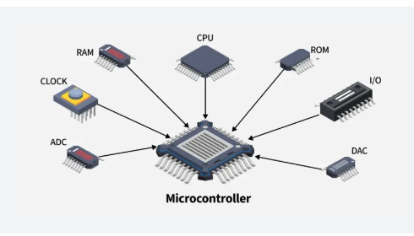
What is a MICROCONTROLLER ?
A microcontroller is a self-contained compute, on an integrated circuit
Access to Memory, CPU, and I/O pins. Allowing you to customize the other components as needed.
From: https://ebics.net/cyclone-iv/

Slide 5
Learning objectives
Digital Inputs & Outputs - Understanding how microcontrollers read and send binary signals.
Analog Inputs & UART - Learning how to capture variable signals and send data through serial communication.
Pulse Width Modulation (PWM) - Generating signals to control devices.

Slide 6
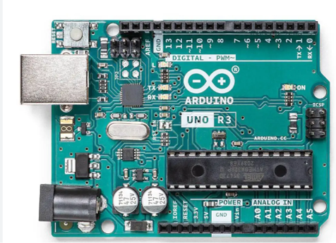
Arduino Uno
Flash: 32 KB (0.5 KB used by bootloader)
SRAM: 2 KB
EEPROM: 1 KB
Digital I/O: 14 pins (D0–D13)
PWM-capable: 6 pins (D3, D5, D6, D9, D10, D11)
Analog Inputs: 6 pins (A0–A5, can also be used as digital I/O)
External Interrupts: 2 pins (D2 = INT0, D3 = INT1)

Slide 7

Programing MCU
Various Integrated Development Environments ( IDEs ) to program the Arduino.
IDEs allows you to tell the computer what to do.
Using the Arduino IDE

Slide 8
There is more to Microcontrollers than this, but you should find this workshop a good introduction.

Slide 9
Questions?

